Slide 1
VoiceFlow: Efficient Text-to-Speech
with Rectified Flow Matching
Yiwei Guo, Chenpeng Du, Ziyang Ma, Xie Chen, Kai Yu
MoE Key Lab of Artificial Intelligence, AI Institute
X-LANCE Lab, Department of Computer Science and Engineering,
Shanghai Jiao Tong University, China

Slide 2
Contents
1
Flows and Diffusions
2
VoiceFlow
3
Experimental Results
4
Conclusion

Slide 3
Flows and Diffusions
🌟 Normalizing flows, diffusions and flow matching models
Normalizing flows: one-step transform $X=f(Z)$, with change-of-variable formula
Single-step transform lacks modeling capability...
Diffusion: an SDE that connects the prior $p_{Z}(z)$ and the data $p_{X}\left(x\right)$.
Reverse-time SDE or probability-flow ODE.
But too many sampling steps…
Anyway, model the transformation of $p_{t}(x)$.
$$p_{X}\left(x\right)=p_{Z}\left(f^{−1}\left(x\right)\right)\left|\det{\frac{∂f^{−1}\left(x\right)}{∂x}}\right|$$

Slide 4
Flows and Diffusions
Why not model $p_{t}\left(x\right)$ directly?
Flow matching models consider a general ODE
$φ_{t}\left(x\right)$ is the transformation function. $v_{t}$ is the vector field.
The change-of-variable formula still applies.
Relationship between $v_{t}$ and the probability process $p_{t}\left(x\right)$ is described via the continuity equation.
If we know the vector field, we can draw samples from the prior distribution.
$$\left\{\begin{aligned}\frac{d}{dt}φ_{t}\left(x\right)=v_{t}\left(φ_{t}\left(x\right)\right) \\ φ_{0}\left(x\right)=x\end{aligned}\right.$$

Slide 5
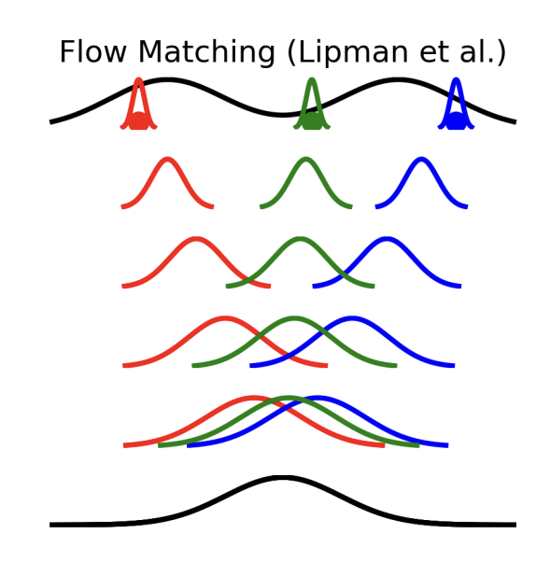
Flows and Diffusions
If we know the vector field, we can draw samples from the prior distribution.
But intractable to know the vector field.
The trick of "conditioning": Build a conditional distribution process $p_{t}(x|x_{1})$ where $x_{1}$ is a data sample. Tractable then.
Similar to "conditional score matching".
$$p_{1}(x_{1})$$
$p_{t}(x|x_{1})$
Image:
Tong et al. Improving and Generalizing Flow-Based Generative Models with Minibatch Optimal Transport. TMLR 03/2024.
$$p_{0}(x_{0})$$

Slide 6
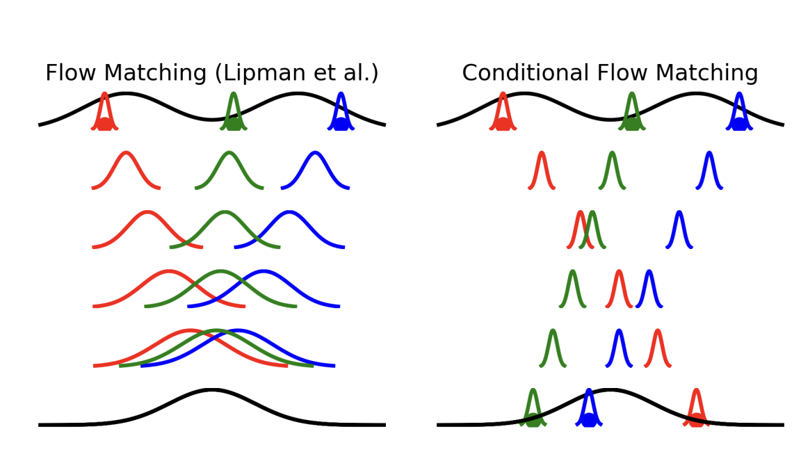
Flows and Diffusions
Additionally conditioning on a prior sample to further improve the conditioning.
Under a certain instantiation, the vector field has a very simple form:
$$v_{t}\left(x | x_{1},x_{0}\right)=x_{1}−x_{0}$$
$$p_{1}(x_{1})$$
$p_{t}(x|x_{1})$
$p_{t}(x|x_{1},x_{0})$
$$p_{0}(x_{0})$$
Image:
Tong et al. Improving and Generalizing Flow-Based Generative Models with Minibatch Optimal Transport. TMLR 03/2024.

Slide 7
Flows and Diffusions
But ODE trajectories will not intersect. This is a basic property of ODE.
Although the trajectories are a straight line in training, those in sampling are still not.
Intersections that will never happen in sampling
Might be the actual sampling trajectory!
Image:
Tong et al. Improving and Generalizing Flow-Based Generative Models with Minibatch Optimal Transport. TMLR 03/2024.

Slide 8
Flows and Diffusions
Then rectified flow emerges.
Train a conditional flow matching model on pairs of $(x_{0},x_{1})$ generated by another flow matching model.
Then the trajectory is "rectified"!
Data sample
Data sample
Flow Rectification Step
Prior sample
Prior sample
Image:
Tong et al. Improving and Generalizing Flow-Based Generative Models with Minibatch Optimal Transport. TMLR 03/2024.

Slide 9
Contents
1
Flows and Diffusions
2
VoiceFlow
3
Experimental Results
4
Conclusion

Slide 10
VoiceFlow: Efficient TTS with Rectified Flow
Improve the sampling speed of TTS, with no degradation on performance, compared to diffusion models.
Rectified flow matching is much more efficient. Requires less sampling steps than diffusion models.
Prior works on speeding-up diffusion-based TTS models rely on progressive distillation, better SDE solver, better noise schedules, etc.

Slide 11
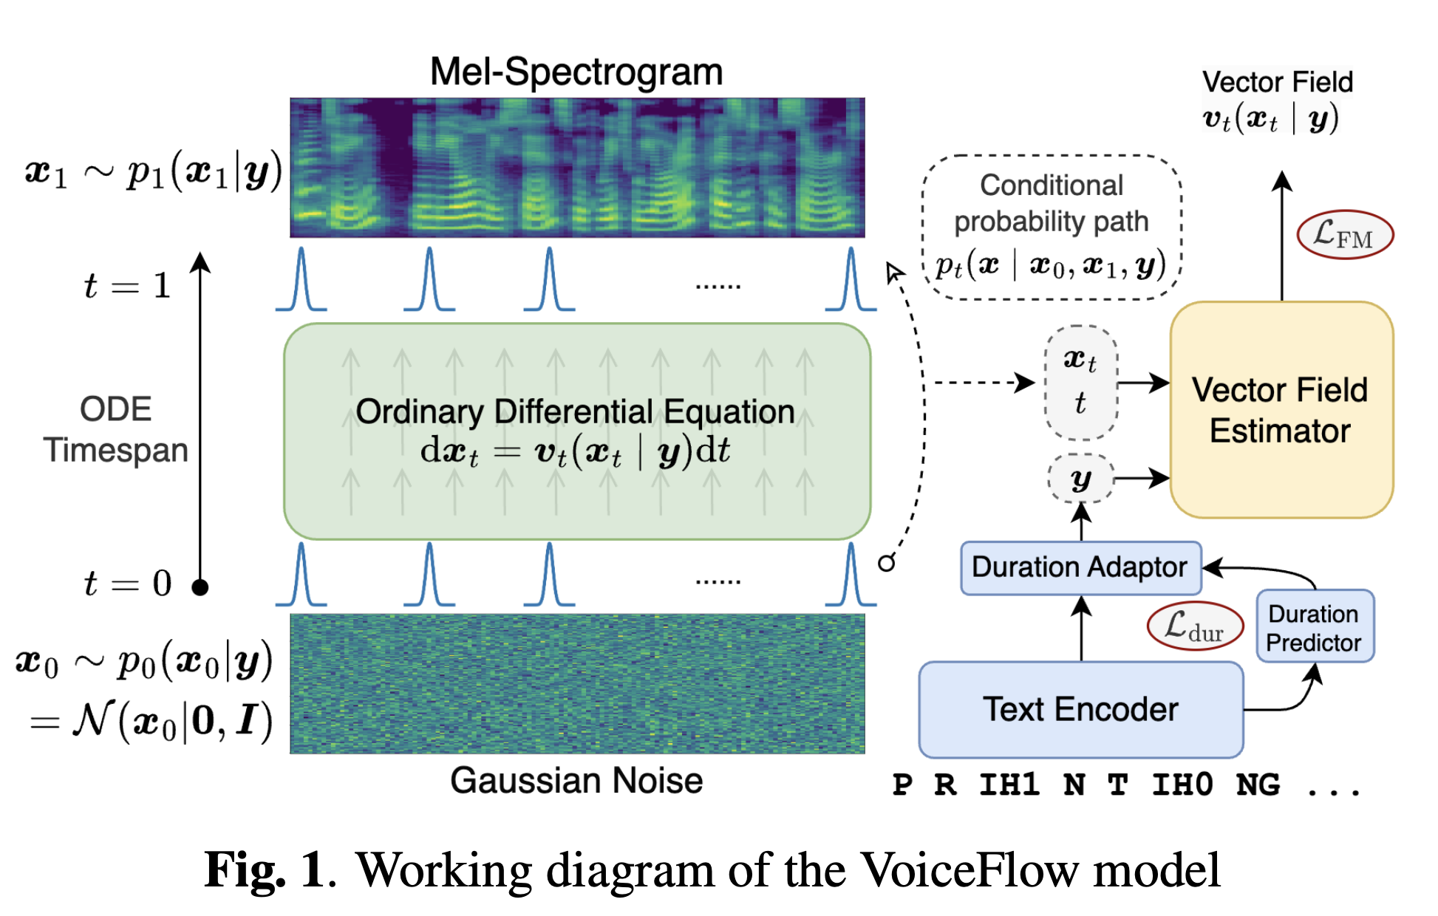
VoiceFlow: Efficient TTS with Rectified Flow
Non-autoregressive TTS. Treat the aligned phonemes as a condition for the flow matching ODE.
Model structure almost identical to GradTTS. Only the algorithmic differences.
UNet structure with two ups and downs.

Slide 12
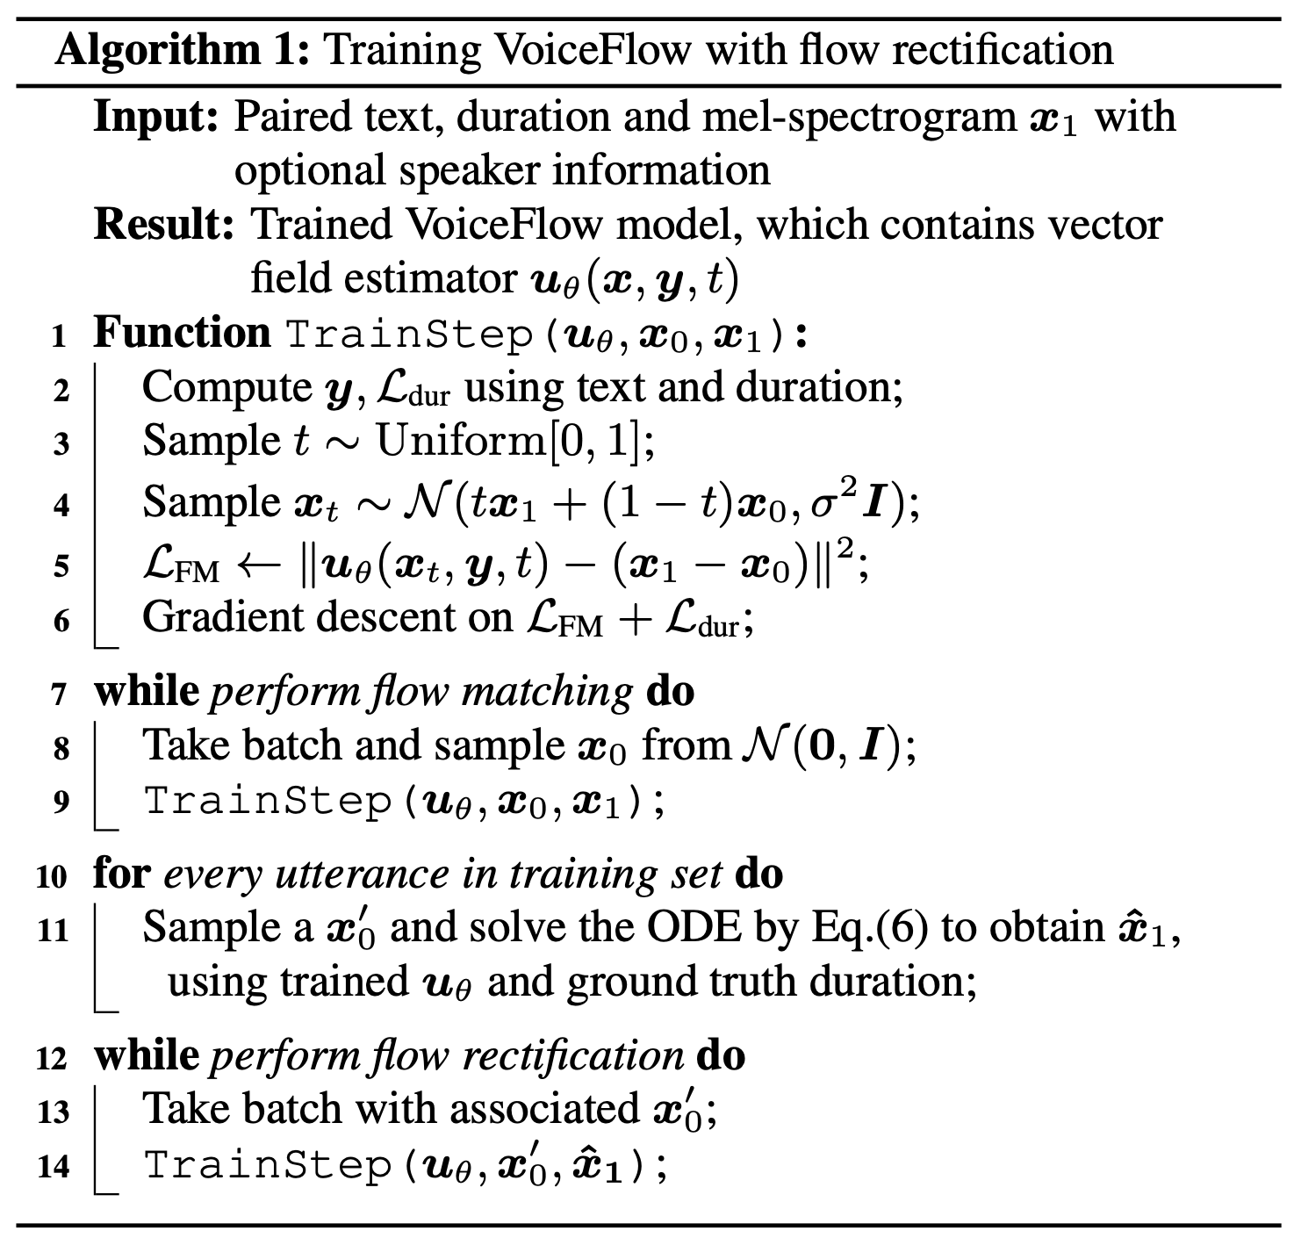
VoiceFlow: Efficient TTS with Rectified Flow
First stage:
vanilla flow matching
Generate samples
Second stage:
rectified flow matching

Slide 13
VoiceFlow: Efficient TTS with Rectified Flow
To sample, just perform a few Euler steps on the ODE, starting from noise:
But as the trajectory will be straightforward, $N$ can be very small (1-2 steps).

Slide 14
Contents
1
Flows and Diffusions
2
VoiceFlow
3
Experimental Results
4
Conclusion

Slide 15
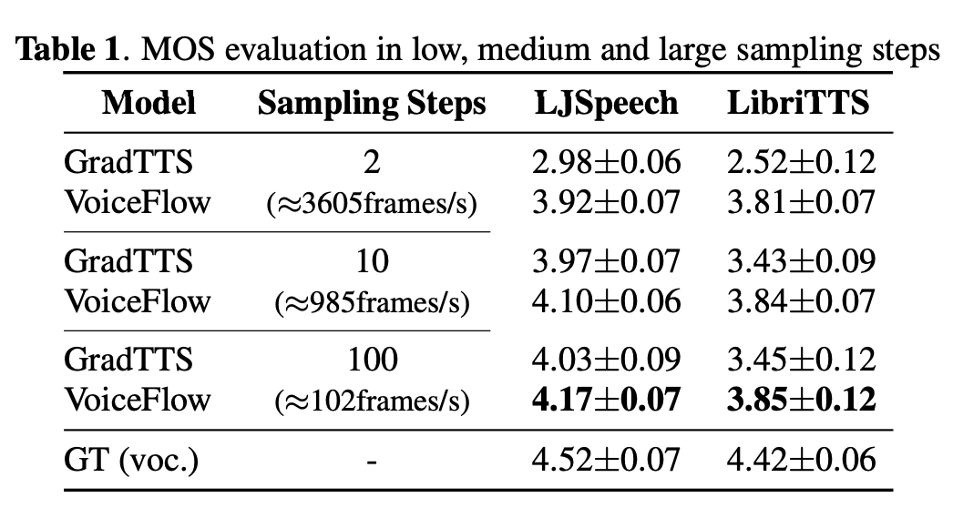
Experimental Results
Trained both on LJSpeech (singler-speaker, high-quality, 24h) and LibriTTS (multi-speaker, varied quality, 585h).
HifiGAN vocoder.
Durations from Kaldi forced alignment, in 12.5ms frame shift.
Baseline: Diffusion-based GradTTS (identical model architecture and size).
With few sampling steps, VoiceFlow outperforms GradTTS to a great margin.
With sufficient steps, VoiceFlow still outperforms GradTTS.
Regardless of steps, VoiceFlow has a decent performance.

Slide 16
Experimental Results
QR code to demo page
And recognized as one of the frequenters of the bogus law-stationers. His arrest led to that of others.
GT (voc.)
GradTTS (2 steps)
VoiceFlow (2 steps)
GradTTS (100 steps)
VoiceFlow (100 steps)

Slide 17
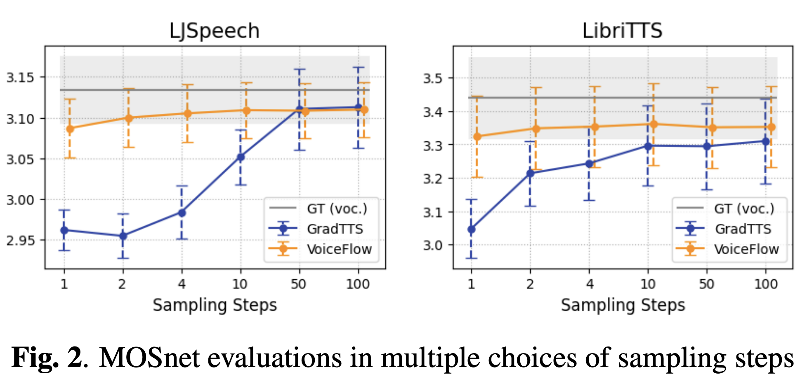
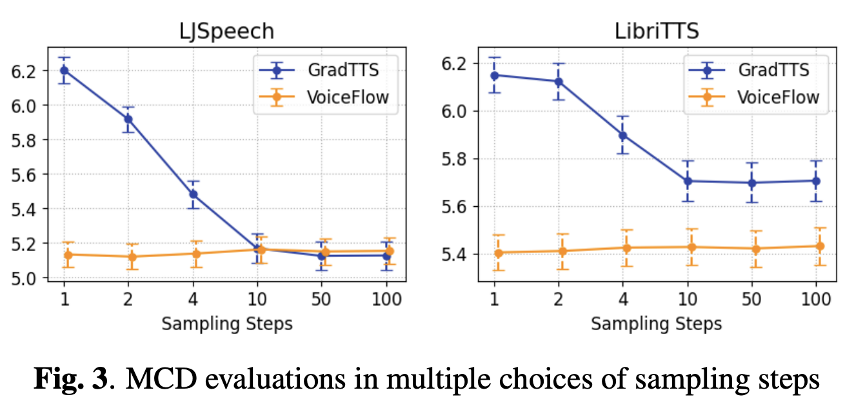
Experimental Results
Objective MOSnet and MCD evaluations on more choices of sampling steps.
QR code to demo page

Slide 18
Experimental Results
QR code to demo page
On occasion the Secret Service has been permitted to have an agent riding in the passenger compartment with the President.
VoiceFlow (2 steps)
VoiceFlow (No ReFlow, 2 steps)

Slide 19
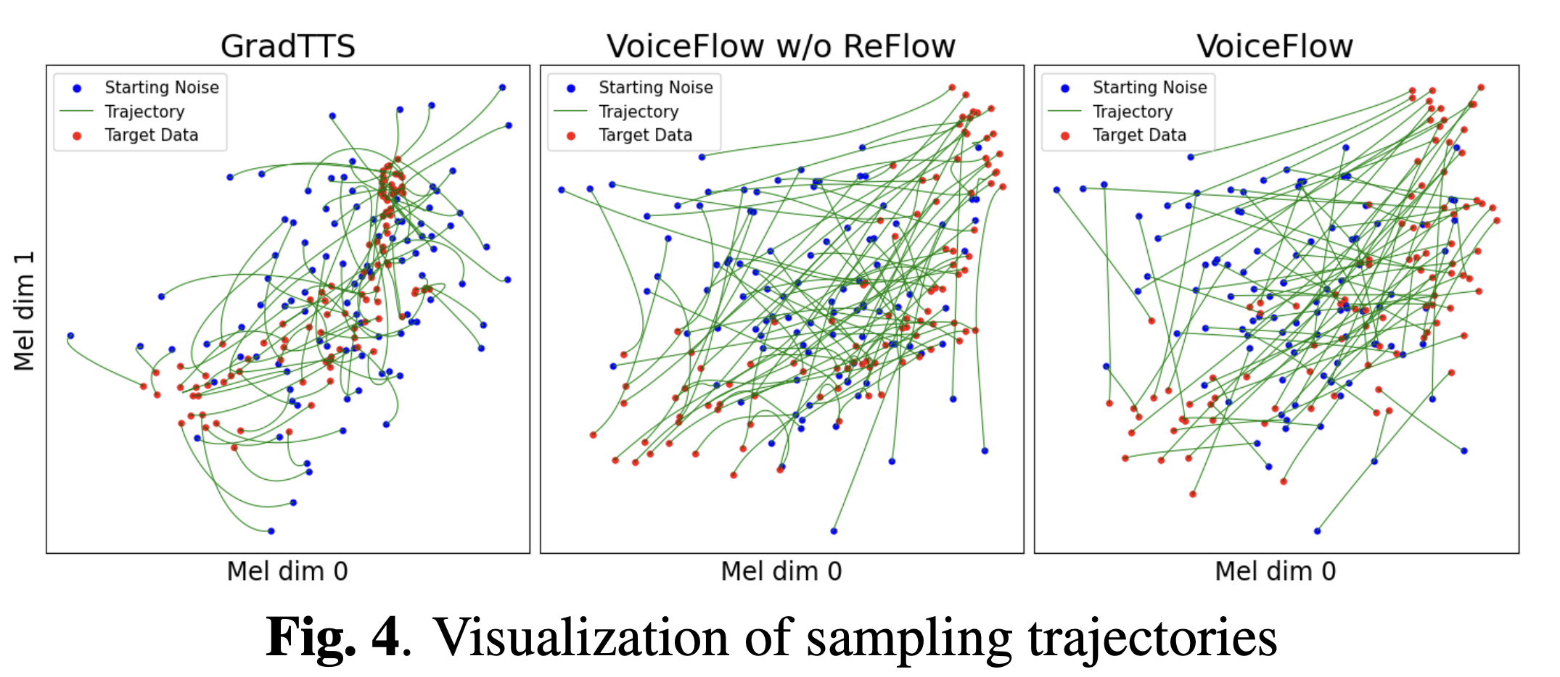
Experimental Results
QR code to demo page
The flow rectification step effectively straighten the sampling trajectory!

Slide 20
Contents
1
Motivation
2
Architecture of UniCATS
3
Experimental Results
4
Conclusion

Slide 21
Conclusion
VoiceFlow leverages rectified flow matching.
The trajectory of sampling mel-spectrograms is highly straightforward.
Improved sampling efficiency compared to diffusion-based models.
Outperforms GradTTS with identical model structure in various steps.
Rectified flow matching is thus a handy choice for TTS.
Code and samples are available.
QR code to demo page

Slide 22
Some Easter Eggs
Some experimental functionalities in the code:
Voice conversion. Flow matching has the potential for voice conversion.
Likelihood estimation, with instantaneous change-of-variable and Skilling-Hutchinson trace estimator.
(Possibly) even more straight sampling trajectory, by optimal transport theories.
Alignment learning, similar to GlowTTS and RADTTS.
Exploration on the architecture, like ReFlow-TTS & DiffSpeech, Matcha-TTS, etc.
Please leave us a star if you find something interesting!
QR code to demo page

Slide 23
Thank You

