Slide 1
EmoDiff: Intensity Controllable Emotional Text-to-Speech with Soft-Label Guidance
Yiwei Guo, Chenpeng Du, Xie Chen, Kai Yu
The 48th International Conference on Acoustics, Speech, & Signal Processing, 2023

Slide 2
Contents
1
Introduction and Related Work
2
Diffusion Models and Classifier Guidance
3
Soft-Label Guidance and EmoDiff
4
Experiments
5
Conclusion

Slide 3
Introduction and Related Work
Current TTS models can already synthesize high-quality and natural speech, such as GradTTS, VITS, VQTTS …
Emotion, as a special expression of speech prosody, often has specifically labeled datasets to utilize.
However, most emotional TTS models can only synthesize emotional speech with certain emotion labels, without intensity controllability.
We need an emotional TTS model that can generate emotion with intensity $α$.
Emotion $e$
TTS model
Intensity $α$

Slide 4
Introduction and Related Work
Manipulation on the emotion embedding space (Um, Se-Yun et al 2020; Im, Chae-Bin et al 2022; etc.).
Pre-calculation of emotion intensity values using handcrafted optimization problem called relative attribute rank (Zhu, Xiaolian et al 2019; Lei Yi et al 2021; Schnell, Bastian et al 2021; Choi, Heejin et al 2021; Lei Yi et al 2022; Zhou Kun et al 2022)
max-margin optimization problem, solved by support vector machines.
The output is defined as emotion intensity, and is used for training and control.
Problem: not direct, not accurate and may cause degradation to speech quality.
Our method: Diffusion model with proposed "soft-label guidance"!

Slide 5
Contents
1
Introduction and Motivation
2
Diffusion Models and Classifier Guidance
3
Soft-Label Guidance and EmoDiff
4
Experiments
5
Conclusion

Slide 6
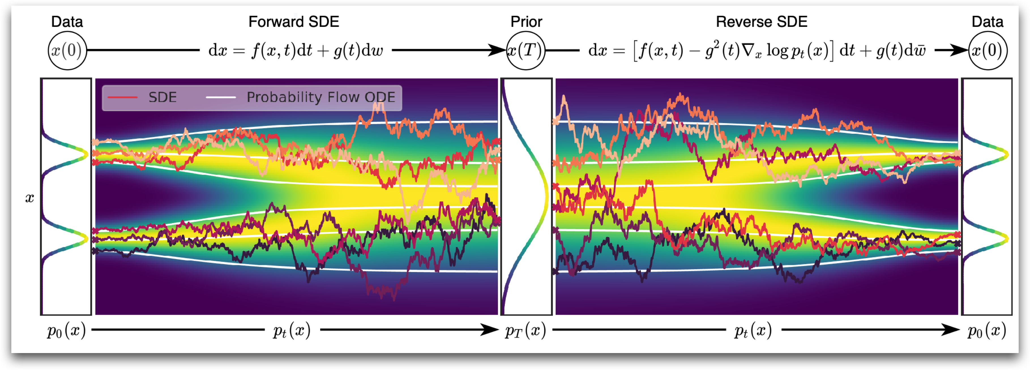
Diffusion Models and Classifier Guidance
In the SDE interpretation of diffusion models, they operate on the "score function" of probability density at arbitrary timestep $t$.
Image: Song et al. score-based generative modeling through stochastic differential equations. 2021

Slide 7
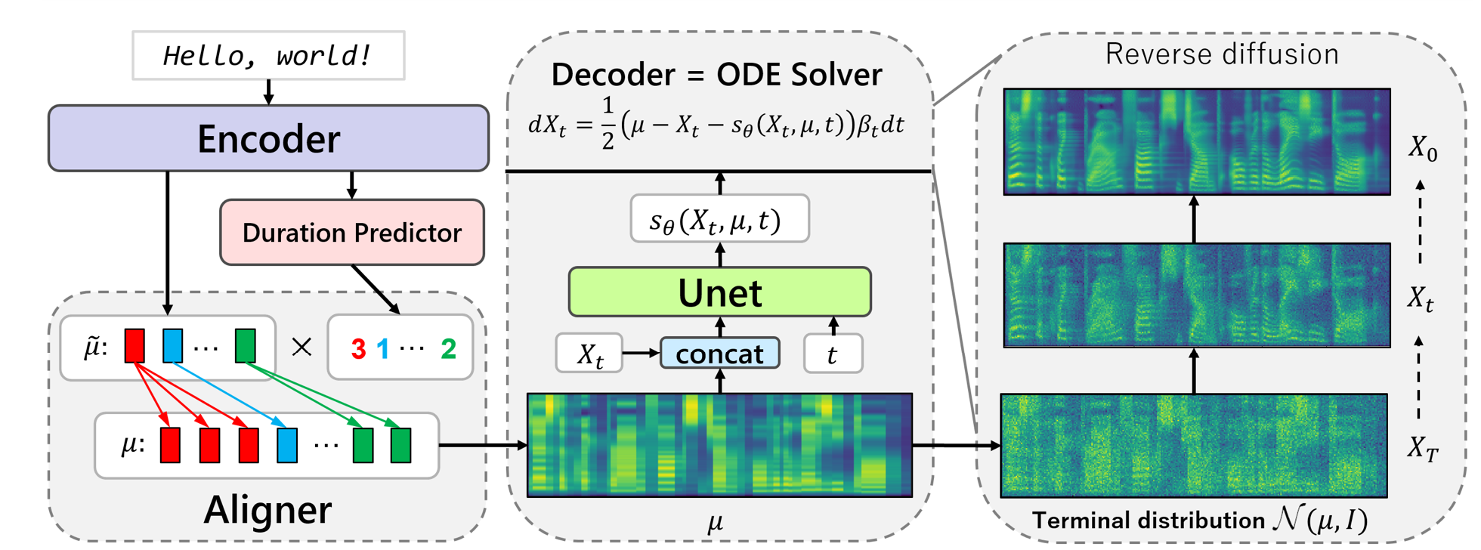
Diffusion Models and Classifier Guidance
Our model is based on GradTTS, a diffusion-based acoustic model.
Image: Popov et al. Grad-TTS: A Diffusion Probabilistic Model for Text-to-Speech. 2021

Slide 8
Diffusion Models and Classifier Guidance
Classifier guidance is a popular technique used in diffusion models. They provide a new way to do conditional sampling for diffusion models.
With classifier guidance, we only need to train a classifier $p(c|x)$ on diffusion trajectory $x_{t}$ to generate conditional samples. The gradient of classifier is to "guide" the unconditional diffusion model.
Conditional density
Conditional Sampler
Classifier output
Unconditional density
Unconditional diffusion model

Slide 9
Contents
1
Introduction and Motivation
2
Diffusion Models and Classifier Guidance
3
Soft-Label Guidance and EmoDiff
4
Experiments
5
Conclusion

Slide 10
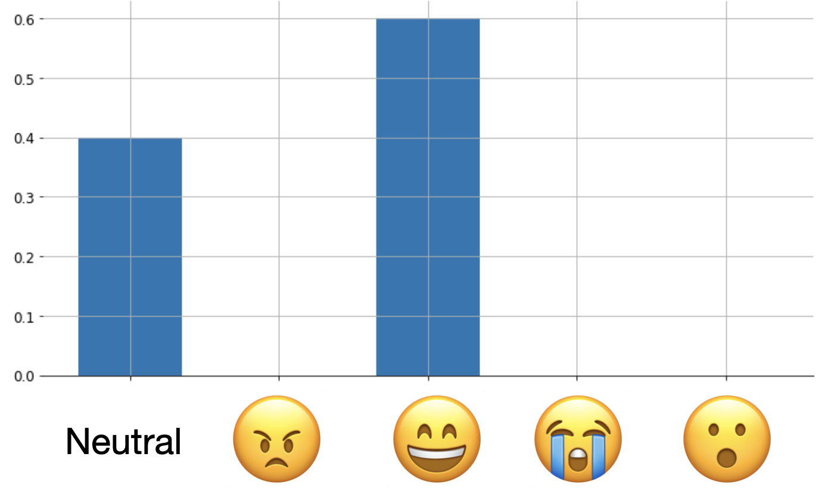
Soft-Label Guidance and EmoDiff
The classifier term so far is only valid for discrete one-hot class labels, e.g. a single emotion.
If we are to control emotion with intensity, this formula needs to be extended.
Hence, we design a Soft-Label Guidance technique based on classifier guidance.
Notation: $e_{i}$ for some emotion label, and $e_{i}$ for its one-hot vector. Leave $e_{0}$ out for Neutral label (i.e. emotion with zero-valence, zero-arousal).
For emotion $e_{i}$ with intensity $α$, denote its vector form as $d=αe_{i}+\left(1−α\right)e_{0}.$

Slide 11
Soft-Label Guidance and EmoDiff
For emotion $e_{i}$ with intensity $α$, denote its vector form as $d=αe_{i}+\left(1−α\right)e_{0}.$
Then, we define:
Intuitively, we want the guidance from $d$ to be a linear combination of pure emotion $e_{i}$ and Neutral $e_{0}$, as $d$ itself is defined by linear combination.
Intensity $α$ is then a "contribution" of the force by emotion $e_{i}$.
Thus, classifier guidance equation can be extended to
All we need is a classifier to output

Slide 12
Soft-Label Guidance and EmoDiff
Generally speaking, this can be extended further to tackle mixture of multiple emotions.
Denote $d=\sum_{i=0}^{m−1}{w_{i}e_{i}}$ as a linear combination of all emotions. Here $\sum_{i=0}^{m−1}{w_{i}}=1.$
We can further generalize to
Sampling $d$ is equivalent to minimize the cross entropy above.
Cross Entropy between specified distribution $p_{e}(∙)$ and classifier output.
$p_{e}(∙)$ is a categorical distribution with probabilities $\{w_{i}\}$.

Slide 13
Soft-Label Guidance and EmoDiff

Slide 14
Contents
1
Introduction and Motivation
2
Diffusion Models and Classifier Guidance
3
Soft-Label Guidance and EmoDiff
4
Experiments
5
Conclusion

Slide 15
Experiments: Setup
Dataset: Emotional Speech Dataset (ESD) from Zhou Kun et al. 2021.
English part; 10 speakers; Emotion Angry, Happy, Sad, Surprise and Neutral.
350 parallel utterances for each speaker per emotion.
GradTTS acoustic model trained on all 10 speakers for 11M steps, and classifier trained on a specific speaker. HifiGAN is used as vocoder.
Classifier: 4-layer 1D CNN, with BatchNorm and Dropout.

Slide 16
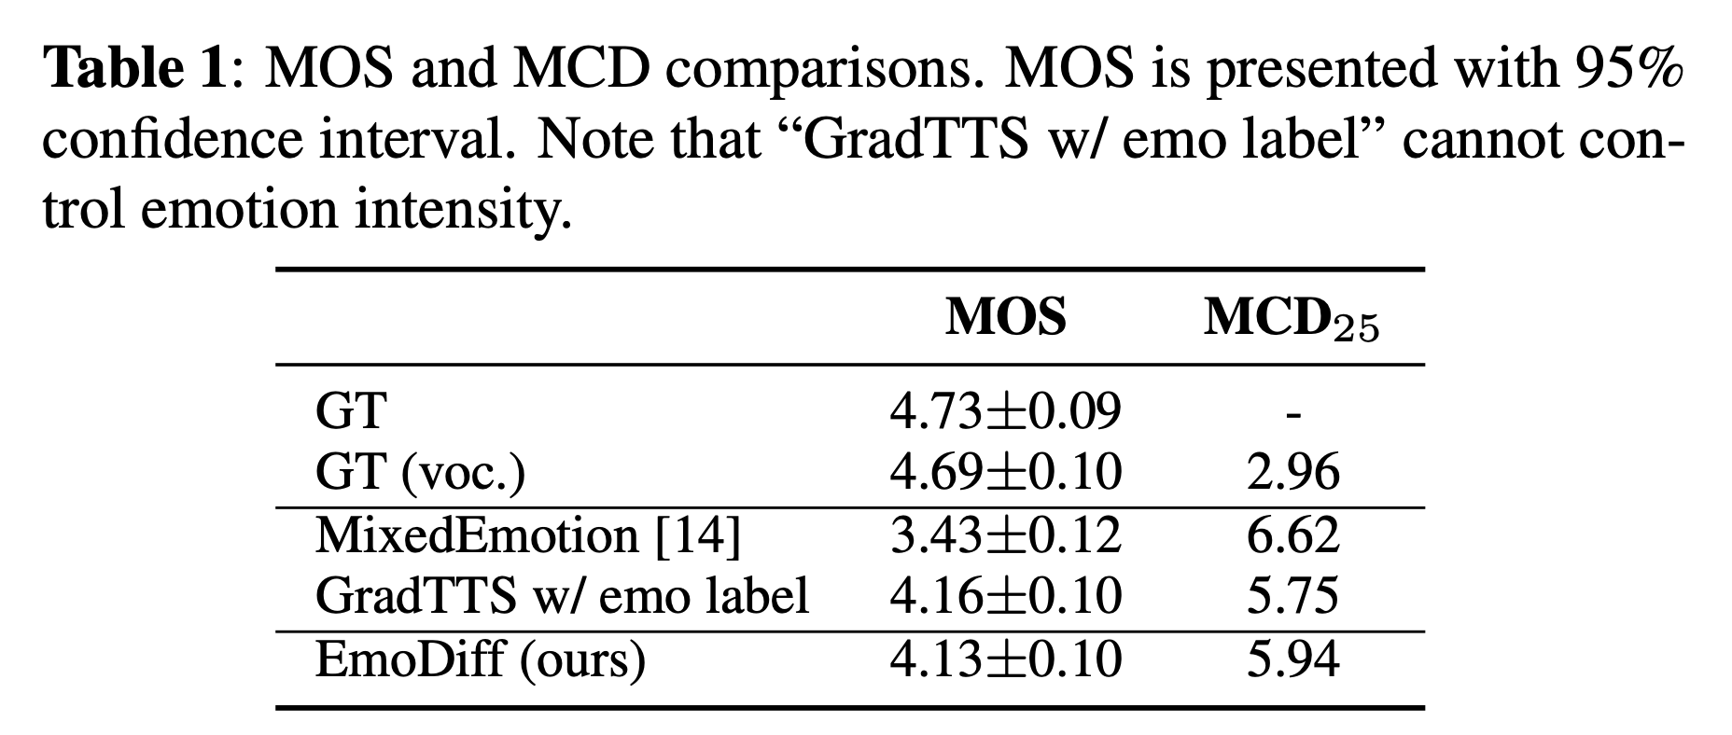
Experiments: Emotional TTS Quality
Compare EmoDiff with followings:
GT and GT(voc.)
MixedEmotion proposed by Zhou Kun et al. 2022. It is based on pre-calculation of emotion intensity by relative attribute ranking.
GradTTS w/ emo label. We provide hard emotion labels into GradTTS. This is to test how a normal emotional acoustic model can perform.
Intensity here is set to be 1.0 (full emotion).
GT
MixedEmotion
GradTTS w/ emo label
EmoDiff

Slide 17
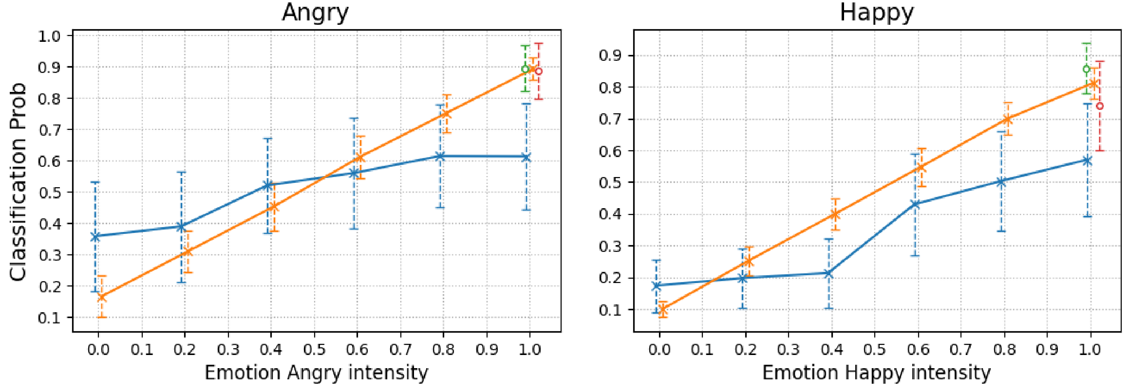
Experiments: Emotion Intensity Controllability
Use the trained classifier to discriminate emotional speech under different intensities.
Larger classification probability means better discriminative confidence.
Surprise
Angry
0.0
1.0

Slide 18
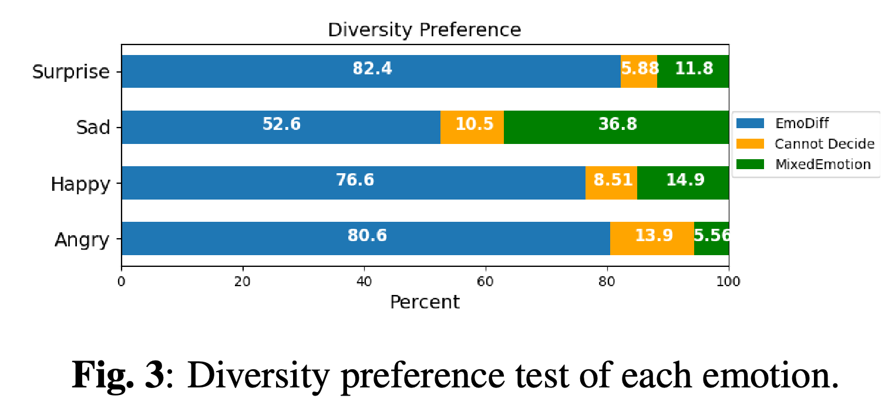
Experiments: Diversity of Emotional Samples
EmoDiff is able to generate highly diverse emotional samples even if under the same emotion.
EmoDiff
MixedEmotion

Slide 19
Contents
1
Introduction and Motivation
2
Diffusion Models and Classifier Guidance
3
Soft-Label Guidance and EmoDiff
4
Experiments
5
Conclusion

Slide 20
Conclusion
Emotion with intensity control, instead of only emotion.
Define emotion with intensity to be a weighted sum of Neutral and another emotion.
We extend classifier guidance to soft-label guidance, which enables us to directly control any arbitrary emotion with intensity.
With an acoustic model and an emotion classifier, EmoDiff can achieve simple but effective control on emotion intensity.
Better TTS quality, intensity controllability and sample diversity.
Future work: soft-label guidance can be generalized to control mixed and natural emotions!

Slide 21
Thanks for listening

